Slide 1
Geometry
Created by Brooke M. McFry
2010

Slide 2
POINT
.

Slide 3
POINT
.
a location in space – a dot on a piece of paper

Slide 4
LINE

Slide 5
LINE
connects two points and continues on indefinitely in both directions

Slide 6
LINE SEGMENT

Slide 7
LINE SEGMENT
part of a line between two points

Slide 8
RAY

Slide 9
RAY
a line that has an endpoint at one end and that goes on indefinitely at the other end

Slide 10
ANGLE

Slide 11
ANGLE
two rays that are connected at the endpoint

Slide 12
ACUTE ANGLE

Slide 13
ACUTE ANGLE
an angle that measures less than 90º

Slide 14
OBTUSE ANGLE

Slide 15
OBTUSE ANGLE
an angle that measures more than 90º

Slide 16
RIGHT ANGLE

Slide 17
RIGHT ANGLE
an angle that measures 90º

Slide 18
Parallel LINES

Slide 19
Parallel LINES
two lines that will never intersect

Slide 20
Perpendicular LINES

Slide 21
Perpendicular LINES
two lines that intersect at a 90º angle

Slide 22
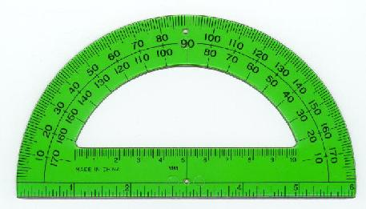
PROTRACTOR

Slide 23
PROTRACTOR
a tool used to measure angles to the nearest degree

Slide 24
What is this?
.

Slide 25
POINT
.
a location in space – a dot on a piece of paper

Slide 26
What is this?

Slide 27
LINE
connects two points and continues on indefinitely in both directions

Slide 28
What is this?

Slide 29
LINE SEGMENT
part of a line between two points

Slide 30
What is this?

Slide 31
RAY
a line that has an endpoint at one end and that goes on indefinitely at the other end

Slide 32
What is this?

Slide 33
ANGLE
two rays that are connected at the endpoint

Slide 34
What is this?

Slide 35
ACUTE ANGLE
an angle that measures less than 90º

Slide 36
What is this?

Slide 37
OBTUSE ANGLE
an angle that measures more than 90º

Slide 38
What is this?

Slide 39
RIGHT ANGLE
an angle that measures 90º

Slide 40
What is this?

Slide 41
Parallel LINES
two lines that will never intersect

Slide 42
What is this?

Slide 43
Perpendicular LINES
two lines that intersect at a 90º angle

Slide 44
What is this?

Slide 45
PROTRACTOR
a tool used to measure angles to the nearest degree

